Slide 1
Organizational Behaviour
Topic : Learning
C.Vijaya Banu, Ph.D
Professor
School of Management
SASTRA Deemed University
Thanjavur

Slide 2
Learning
Any relatively permanent change in behavior that occurs as a result of experience.
Learning
Involves change
Is relatively permanent
Is acquired through experience

Slide 3

Theories of Learning
Classical Conditioning
A type of conditioning in which an individual responds to some stimulus that would not ordinarily produce such a response.
Operant Conditioning
A type of conditioning in which desired voluntary behavior leads to a reward or prevents a punishment.
Social-Learning Theory
People can learn through observation and direct experience.

Slide 4
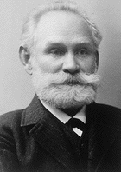
Ivan Petrovich Pavlov
(1849 - 1936)
Russian physiologist

Slide 5
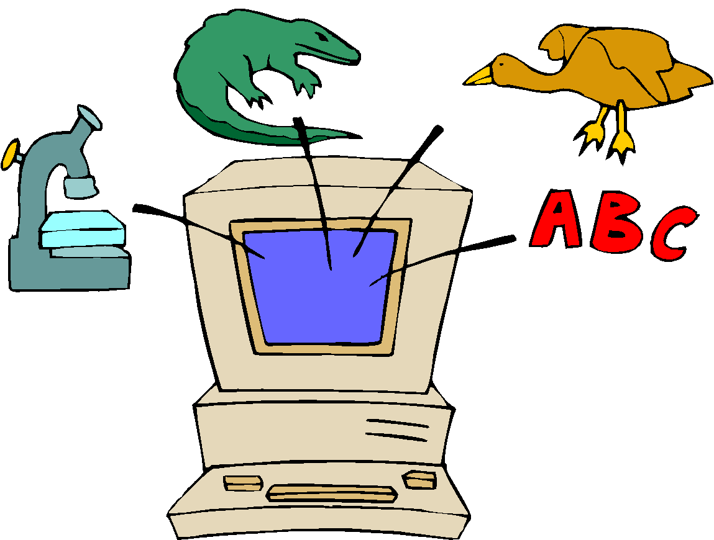
I. Classical Conditioning
Pavlov’s Dog Drool
Key Concepts:
Unconditioned stimulus
A naturally occurring phenomenon.
Unconditioned response
The naturally occurring response to a natural stimulus.
Conditioned stimulus
An artificial stimulus introduced into the situation.
Conditioned response
The response to the artificial stimulus.
This is a passive form of learning. It is reflexive and not voluntary – not the best theory for OB learning.

Slide 6
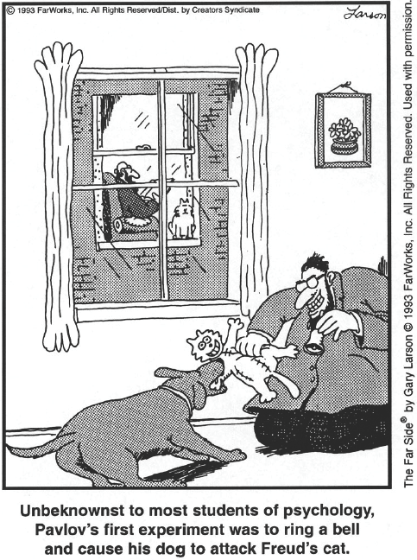
Source: The Far Side ® by Gary Larson © 1993 Far Works, Inc. All rights reserved. Used with permission.

Slide 7
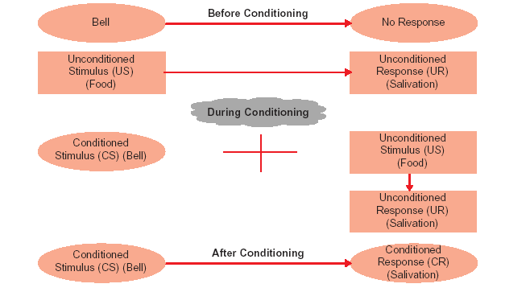
Classical Conditioning

Slide 8
II. Operant Conditioning or Instrumental Conditioning or Skinnerian Conditioning

Slide 9
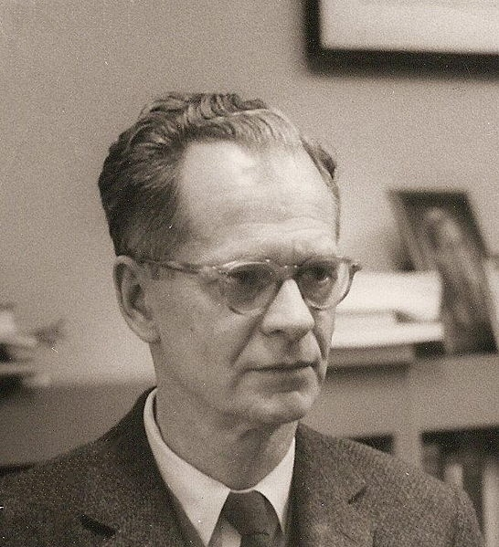

Slide 10
Operant Conditioning
Operant conditioning, also called instrumental conditioning, refers to the process that our behaviour produces certain consequences and how we behave in the future will depend on what those consequences are.
If our actions have pleasant effects, then we will be more likely to repeat them in the future. If, however, our actions have unpleasant effects, we are less likely to repeat them in the future
.

Slide 11
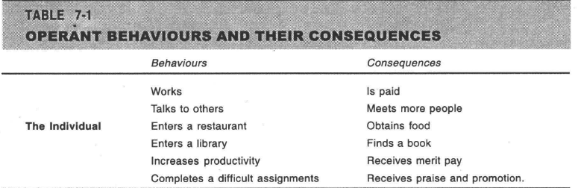
Operant Conditioning

Slide 12
Operant (or Instrumental) Conditioning
A method of learning that occurs through rewards and punishments for behavior. Through operant conditioning, an association is made between a behavior and a consequence for that behavior.
Key Concepts
Reflexive (unlearned) behavior
Conditioned (learned) behavior
Reinforcement

Slide 13
Shaping Behavior
Systematically reinforcing each successive step that moves an individual closer to the desired response.
Key Concepts
Reinforcement is required to change behavior.
Some rewards are more effective than others.
The timing of reinforcement affects learning speed and permanence.

Slide 14
Types of learning processes in Operant Conditioning
… a learning process that involves an increase or decrease in the likelihood of some behavior as a result of the consequences.
Positive reinforcement
Negative reinforcement

Slide 15
Negative Reinforcement vs. Punishment
It is important to not confuse negative reinforcement and negative punishment.
They are different.
Negative reinforcement involves an increase in a behavior.
In contrast, punishment involves a decrease in a behavior.

Slide 16
Methods of Shaping Behavior
Positive reinforcement
Providing a reward for a desired behavior.
Negative reinforcement
Removing an unpleasant consequence when the desired behavior occurs.
Punishment
Applying an undesirable condition to eliminate an undesirable behavior.
Extinction
Withholding reinforcement of a behavior to cause its cessation.

Slide 17
Two Types of Reinforcement Schedules
1. Continuous Reinforcement
2. Partial Reinforcement
2.1 Fixed-ratio schedules
2.2 Variable-ratio schedules
2.3 Fixed-interval schedules
2.4 Variable-interval schedules

Slide 18

Types of Intermittent Reinforcement
Ratio
Depends on the number of responses made.
Interval
Depends on the time between reinforcements.
Fixed
Rewards are spaced at uniform time intervals or after a set number of responses.
Variable
Rewards that are unpredictable or that vary relative to the behavior.

Slide 19
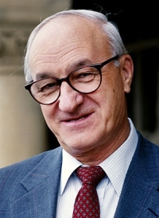

Slide 20

Social-Learning Theory
Based on the idea that people can also learn indirectly: by observation, reading, or just hearing about someone else’s – a model’s – experiences.
Key Concepts:
Attention processes
Must recognize and pay attention to critical features to learn.
Retention processes
Model’s actions must be remembered to be learned.
Motor reproduction processes
Watching the model’s behavior must be converted to doing.
Reinforcement processes
Positive incentives motivate learners.

Slide 21
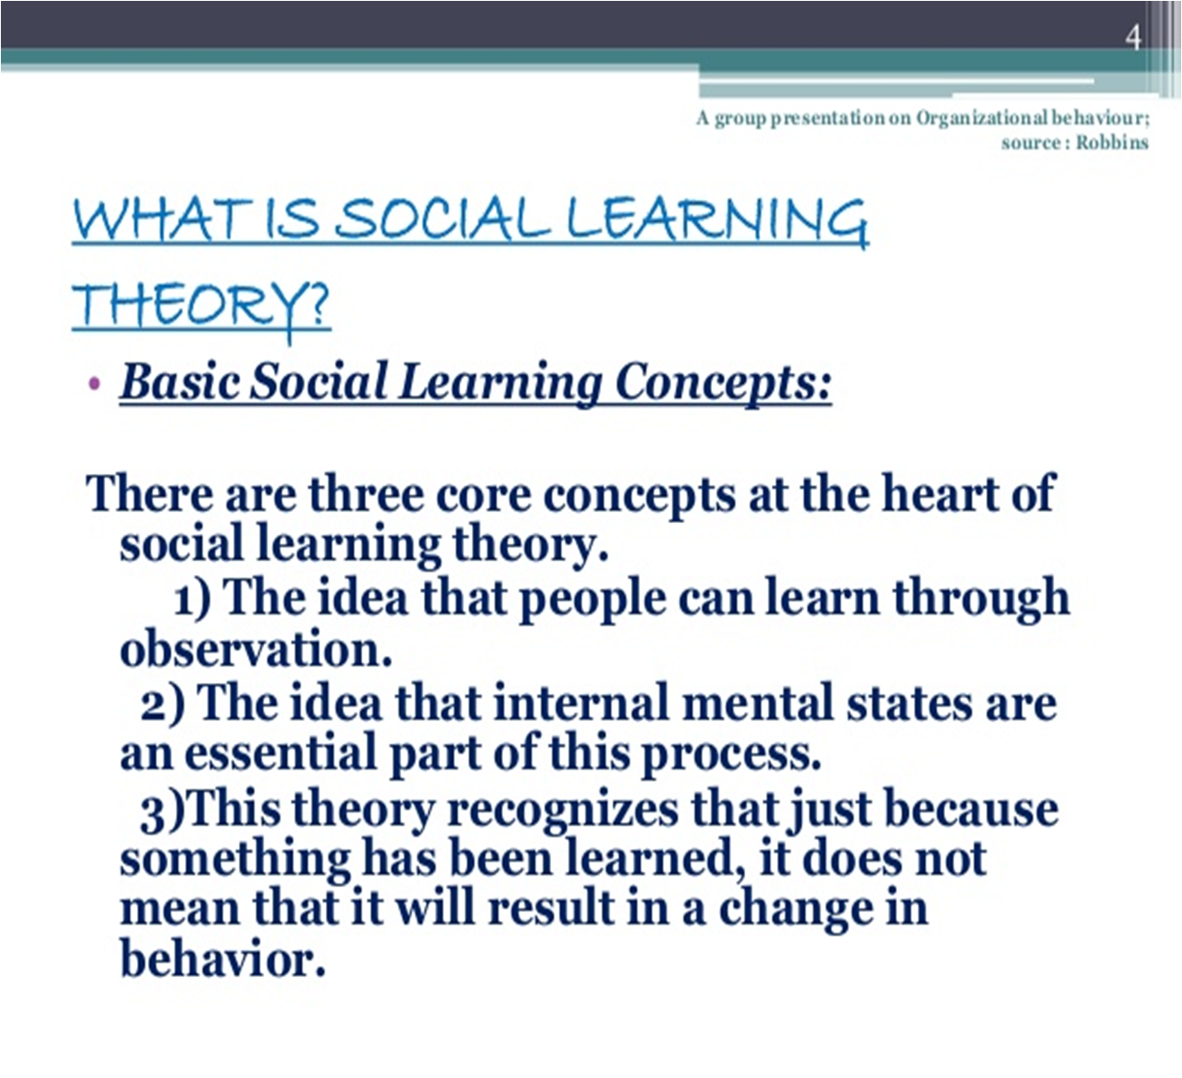
Social-Learning Theory

Slide 22
Learning Principles
Motivation
Reinforcement, punishment and extinction
Whole versus part learning
Learning curves
Meaningfulness of material
Learning styles

Slide 23
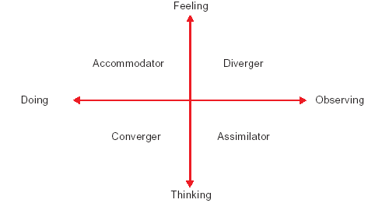
Learning Styles

Slide 24
Learning Styles
Accommodator: An accommodator learns by doing and feeling. He/she tends to learn primarily from hands-on experience. He or she tends to act on gut feeling rather than on logical analysis.
Diverger: A diverger learns by observing and feeling. The diverger has the ability to view concrete situations from different angles. When solving problems, diverger enjoys brainstorming

Slide 25
Learning Styles
Converger: A converger learns by doing and thinking. The converger seeks practical use for
information. When presented with problems and making decisions, the converger tends to focus on solutions.
Assimilator: An assimilator learns by observing and thinking. The assimilator is effective at understanding a wide range of information and putting in to concise and logical form

Slide 26
Thank You

